Slide 1

STRESS CARE CLINIC ANALYSIS
PRESENTATION ON EMPLOYEE STRESS LEVEL
DESIGNED BY VICTORIA JAJA

Slide 2

INTRODUCTION
Employee stress is a growing concern in today’s demanding work environment, as long hours and heavy workloads affect well-being and productivity.
Stress Care Clinic provided a dataset to analyze the causes of workplace stress and find ways to manage it effectively.
This study explores how organizations can use data to create healthier, more supportive workplaces for their employees.

Slide 3

PROBLEM STATEMENT
Stress Care Clinic is worried about the level of stress employees experience and wants to identify the challenges involved or the factors that influence this level of stress.
They aim to improve employee well-being by creating a monitoring system for businesses to track records of employee stress at every given period.

Slide 4
OBJECTIVES
Based on the provided dataset, we aim to analyze;
SOURCE OF STRESS
COPING MECHANISM
HIGH STRESS LEVEL GROUP
STRESS SYMPTOMS

Slide 5
RECOMMENDATION
Source of Stress
Share tasks, hire more staff, and allow breaks to ease workloads.
Set realistic deadlines and teach time management.
Build better team relationships with activities and open communication.
Offer counseling, support groups, and financial education to help employees with personal or financial challenges.
Teach stress management through workshops and relaxation techniques.
Provide equal opportunities for women and stress support for men.
Stress Symptoms
Use ergonomic chairs and encourage stretching for back pain and fatigue.
Create quiet spaces and offer healthy snacks for better relaxation.
Conduct regular health check-ups to catch stress-related issues early.
Encourage exercise, hobbies, and meditation to reduce stress.
Promote healthy eating to manage stress naturally.

Slide 6
RECOMMENDATION
Stress Level Group
Young Females can focus on getting enough sleep, exploring hobbies, meditating, and trying therapy.
Adult Women can consider therapy and maintain a healthy diet to manage stress.
Older and aged Women should try gardening, reading, exercising, and doing hobbies to improve your mood.
Young Men can use therapy, meditation, and hobbies for stress relief.
Adult Men should stick to therapy, hobbies, and meditation to stay balanced.
Older and aged Men can engage in hobbies, walking, gardening, therapy, and talking with family for emotional well-being
Coping Mechanisms
For Extreme Stress, activities like art, sleeping, therapy, and meditation can be considered.
Short-Term Stress can be managed with walking, reading, or talking to loved ones.
For Moderate or Long-Term Stress, exercise, music, and healthy eating can be recommended.
Use surveys to monitor stress and help employees quickly.

Slide 7
DATA CLEANING
Renaming Columns: All column names were renamed to meaningful names for better clarity and organization.
Checking for Duplicates: 19 duplicate rows were identified using row numbers and removed to ensure data uniqueness.
Handling Missing Values: A missing value in the Stress Level Score column was replaced with the average score to maintain data consistency.
Verifying Data Types: The data types of all columns were checked to ensure accuracy in data cleaning.
Removing Unnecessary Spaces: Extra spaces in text columns were trimmed to ensure clean and consistent data.
Standardizing Dates: Date columns were checked to ensure there were no extra spaces or invalid values.
Checking for Outliers: Date columns were verified to ensure no impossible or incorrect values were present.

Slide 8
DATA CLEANING
Calculating Age: An Age column was created and populated using the date of birth and current date.
Classifying Age: Employees were grouped into categories such as Young, Adult, Aged, and Old based on their age.
Classifying Gender: Gender values were standardized to "Male" and "Female" for consistency.
Classifying Stress Scores: Stress Level Scores were rounded to two decimal places and categorized into Low, Mild, High, and Very High.
Classifying Stress Duration: Stress durations were grouped into Short, Average, Long, and Extreme periods for easier analysis.
Classifying Heart Rate and Cortisol: Heart rate and cortisol levels were categorized into meaningful ranges.
Importing Cleaned Data: The cleaned dataset was imported into Excel for further analysis and visualization.

Slide 9
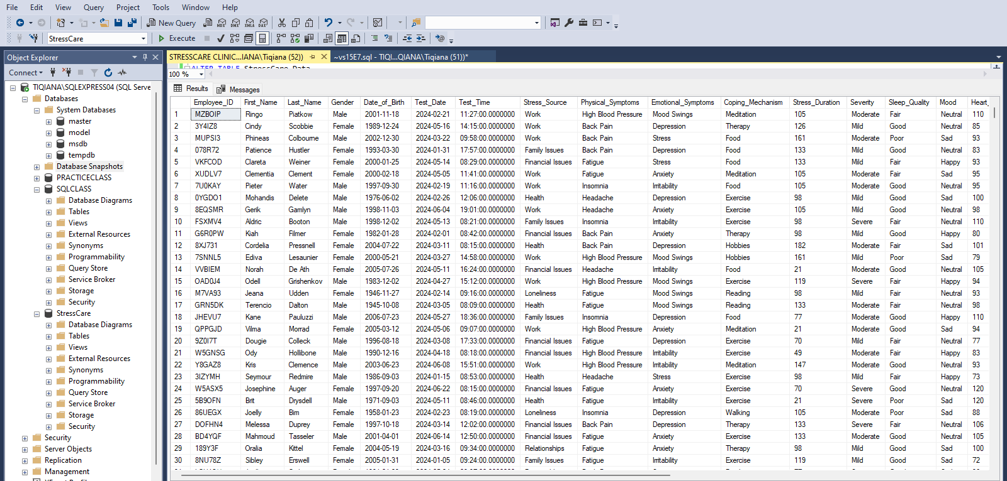
DATASET PREVIEW

Slide 10
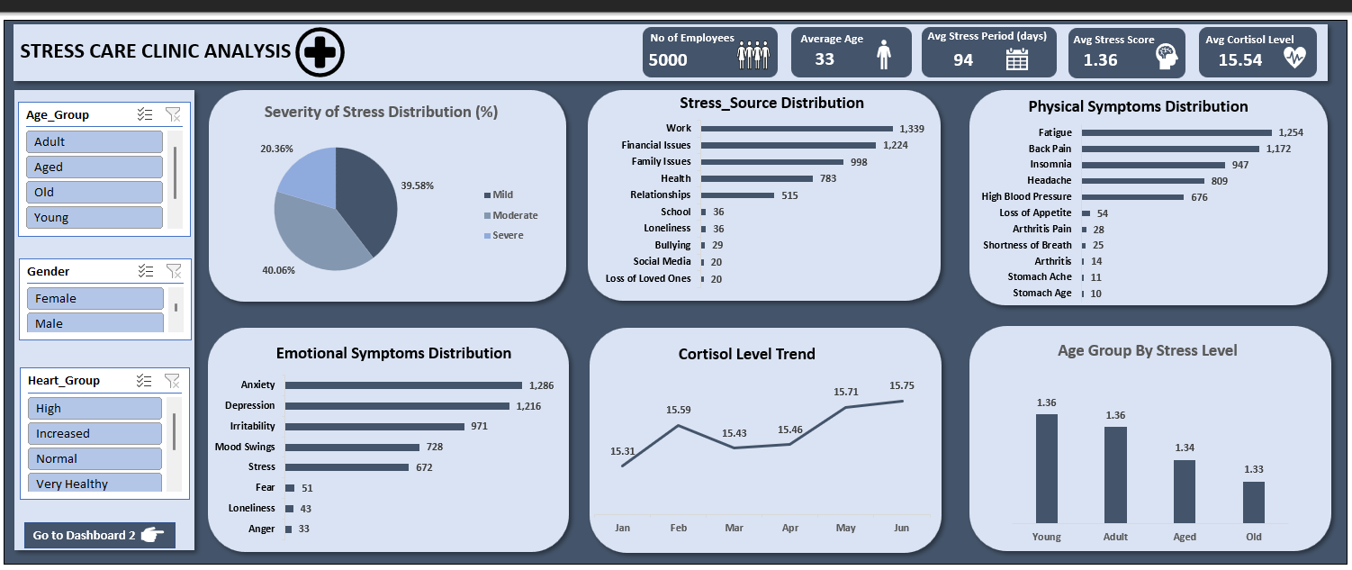
DASHBOARD

Slide 11
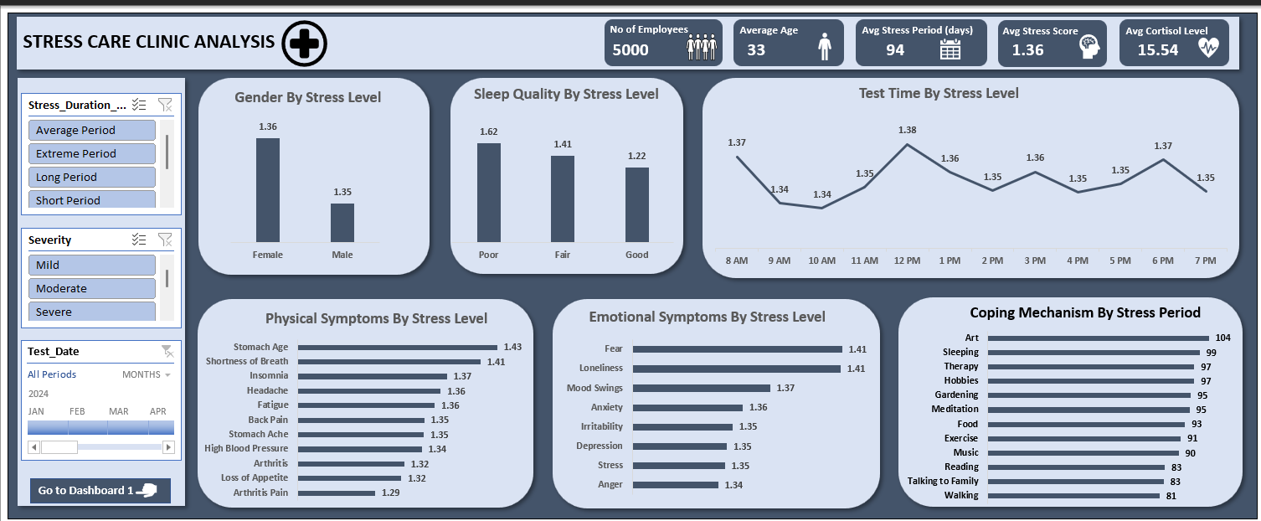
DASHBOARD

Slide 12
KEY PERFORMANCE INDICATORS
From the analysis, the following KPIs were generated;
The total number of employees registered with Stress Care Clinic is 5000.
The average age of employees was calculated to be 33 years.
The average number of days for employee stress level is 94 days.
Based on stress level score, present employees have an average of 1.36.
Based on cortisol level, present employees have an average of 15.54.

Slide 13
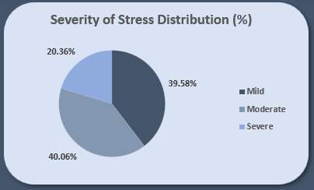
SEVERITY OF STRESS DISTRIBUTION (%)
The pie chart shows that most employees (40.06%) have moderate stress, while 39.58% experience mild stress. About 20.36% face severe stress, which is a serious concern.
Without support, those with moderate stress could move to severe stress over time. Severe stress can harm health, lower work performance, and weaken the immune system.

Slide 14
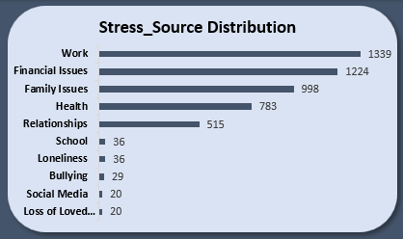
STRESS SOURCE DISTRIBUTION
The bar chart indicates that 1,339 employees are stressed due to work, making it the highest stress source. Financial issues follow at 1,224, reflecting struggles with bills and responsibilities.
Family-related stress affects 998 employees, while health and relationship problems account for 783 and 515 cases, respectively.
These findings highlight the need to address work stress and provide support for financial, family, health, and relationship challenges

Slide 15
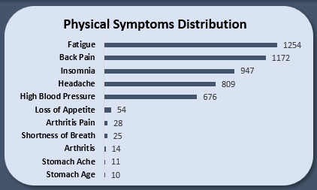
PHYSICAL SYMPTOMS DISTRIBUTION
The chart shows that fatigue (1,254 employees) and back pain (1,172 employees) are the most reported symptoms, likely linked to work posture or stress.
Insomnia, headaches, and high blood pressure also affect 947, 809, and 676 employees, respectively significantly impacting employee well-being, and contributing to higher stress levels.

Slide 16
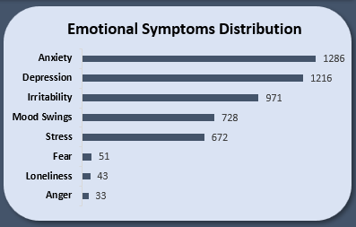
EMOTIONAL SYMPTOMS DISTRIBUTION
The bar chart shows that anxiety, depression, irritability, and mood swings are the most common emotional complaints among employees, which may stem from factors like lack of social support, financial struggles, poor sleep, and other stressors.
Emotional discomfort significantly contributes to rising stress levels in the workplace.

Slide 17
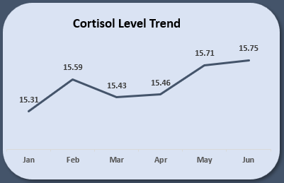
CORTISOL LEVEL TREND
Cortisol is a stress hormone that helps the body function, but too much for a long time can be harmful. The average cortisol level is 15.54, with the highest in June (15.75) and the lowest in January (15.31).
Stress levels slightly rose from February to June, showing that stress builds up over time.
Tracking cortisol levels helps identify when employees feel the most stressed so support can be given at the right time.

Slide 18
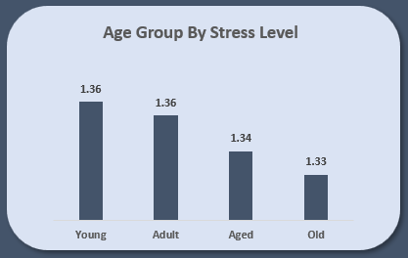
AGE GROUP BY STRESS LEVEL
The column chart shows Younger and adult employees have the highest stress levels (1.36) due to career, family, and societal pressures.
The aged group has slightly lower stress (1.34), possibly because they have fewer work-related challenges, and the old group has the lowest stress (1.33), likely due to fewer responsibilities and a more relaxed life.
Since younger employees experience more stress, they may need extra support to help them manage it better.

Slide 19
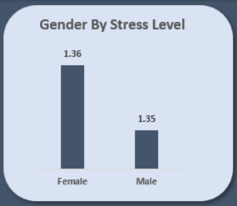
GENDER BY STRESS LEVEL
Stress levels for males (1.35) and females (1.36) are almost the same, showing that both experience similar stress levels.
However, the causes of stress might be different for each gender. A balanced approach can help everyone manage stress better

Slide 20
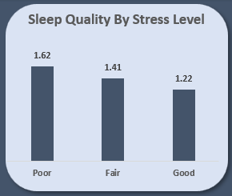
SLEEP QUALITY BY STRESS LEVEL
The chart shows that people with poor sleep quality have the highest stress levels, while those with good sleep quality have the lowest stress.
Poor sleep can make it harder to manage stress, creating a cycle of stress and bad sleep. On the other hand, good sleep helps reduce stress and improves overall well-being.
.

Slide 21
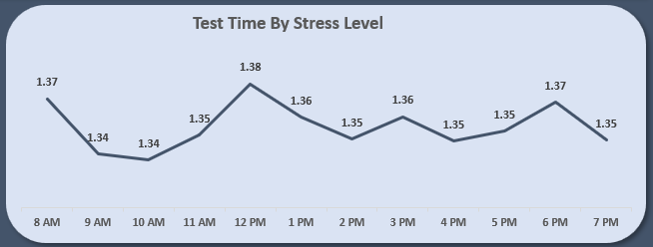
TEST TIME BY STRESS LEVEL
Employees have high stress at 8 am, likely due to morning routines, at 12 pm from workload pressures, and again at 5–6 pm with end-of-day tasks.
Understanding these times can help target support to reduce stress during these peak moments.

Slide 22
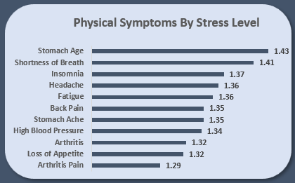
PHYSICAL SYMPTOMS BY STRESS LEVEL
Employees showing symptoms like stomach age, shortness of breath, and insomnia are likely under high stress, which could affect their health and performance if not addressed. Headache and fatigue are also stress-related and should be monitored closely.
Early signs like back pain or loss of appetite may indicate moderate stress, and taking action early can prevent it from worsening.

Slide 23
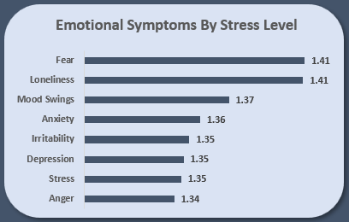
EMOTIONAL SYMPTOMS BY STRESS LEVEL
Fear, loneliness, and mood swings are closely linked to high stress and indicate that employees might need immediate support. Anxiety, irritability, and depression show ongoing emotional challenges that could worsen if not addressed.
Anger and general stress are less strongly tied to stress but still need monitoring. Supporting employees with these symptoms can improve their well-being and prevent issues from escalating.

Slide 24
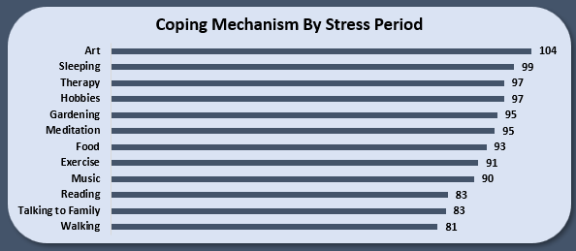
COPING MECHANISM BY STRESS PERIOD
This approach highlights how different coping mechanisms affect stress duration.
Different coping methods help with stress depending on how strong or long it lasts.
For extreme stress, activities like art, therapy, and meditation work well, while short-term stress is often managed with walking, reading, or talking to family. Exercise, food, and music are helpful for both moderate and long-term stress.

Slide 25

CONCLUSION
Stress Care Clinic can make the workplace better by balancing workloads, offering stress programs, and improving comfort. Supporting all ages and genders with health check-ups will keep everyone healthy and happy.

